Slide 1
Fake News Research Project Final Report
Marian Longa, 08/09/2017
Supervisors: Axel Oehmichen, Miguel Molina-Solana
Data Science Institute, Imperial College London

Slide 2
Introduction
Problem: given the metadata about tweets related to the 2016 US election, implement a classifier to best categorize the tweets as “fake news” and “other type of news”.
Solution:
Go through the list of tweets and manually label each one as “fake news” or “other type of news” (also label each “fake” tweet as one of 5 “fake news” subcategories)
Use the tweet metadata to engineer base and derived features
Calculate which features best separate the ”fake” and “other” news classes
Use subsets of those features to create different feature sets and test the classification performance of each feature set using logistic regression
Out of these, choose the feature set which obtains the highest classification score in logistic regression
Use this best feature set to train and test different types of classifiers, varying their hyperparameters and noting the corresponding classification scores
When the hyperparameters for each classifier model are optimized, compare the models and select the model with highest classification score

Slide 3
Feature engineering and selection

Slide 4
Feature selection method
Download 23 tweet fields from tweet database: tweet_id, created_at, retweet_count, text, user_screen_name, user_verified, user_friends_count, user_followers_count, user_favourites_count, tweet_source, geo_coordinates, num_hashtags, num_mentions, num_urls, num_media, user_default_profile_image, user_description, user_listed_count, user_name, user_profile_use_background_image, user_default_profile, user_statuses_count, user_created_at (green denotes newly added features w.r.t. previous paper)
Define 85 base + derived features (check character types, calculate per-unit-time quantities, determine trends from histograms)
For each feature calculate:
the difference in mean ∆µ between ‘fake’ and ‘other’ classes after scaling the feature data to µ=0, σ=1
the p-value corresponding to a t-test performed on the unscaled ‘fake’ and ‘other’ classes
Eliminate features with high p-value

Slide 5
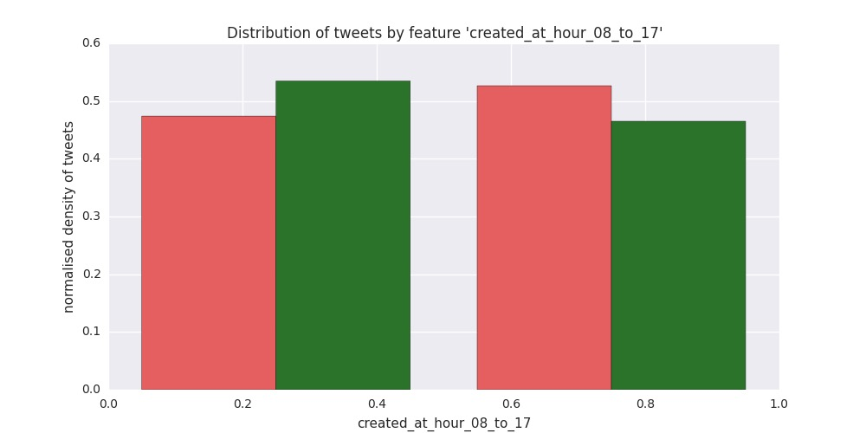
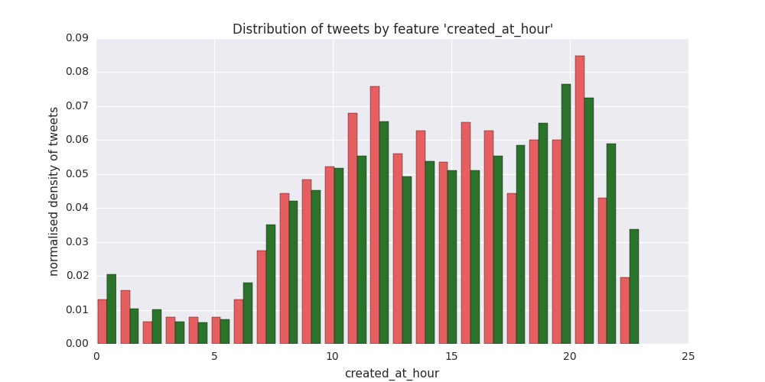
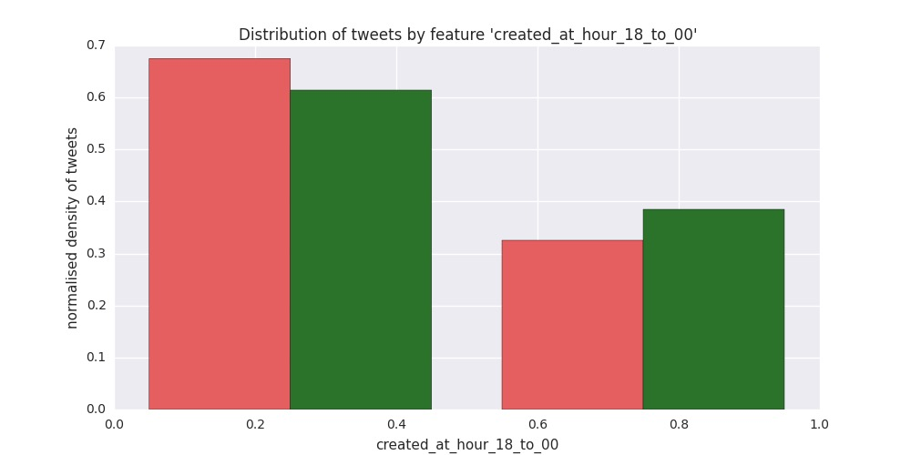
‘created_at_hour’ related features
false
true
∆µ = 0.122, p = 0.00166
false
true
∆µ = -0.125, p = 0.00124

Slide 6
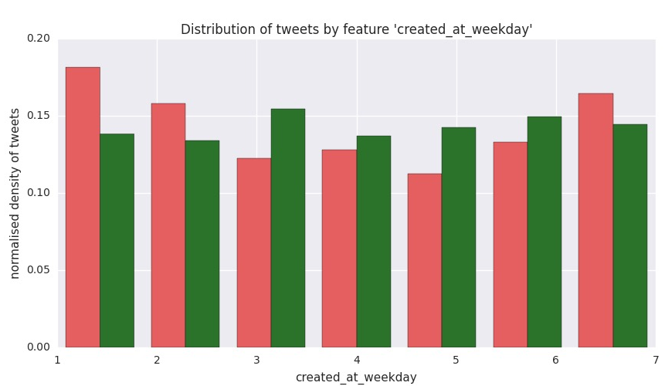
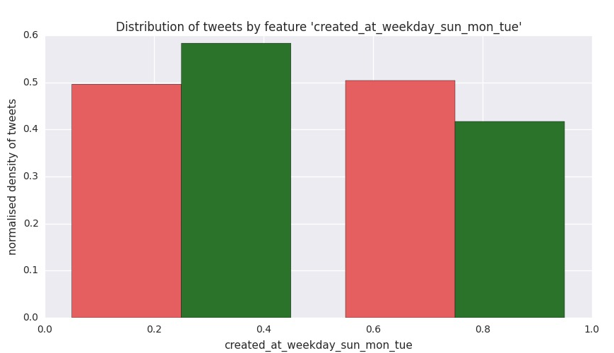
‘created_at_weekday’ related features
false
true
∆µ = 0.176, p = 0.00000532

Slide 7
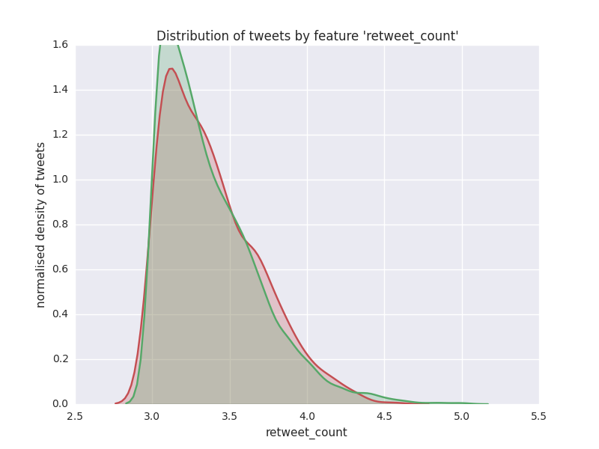
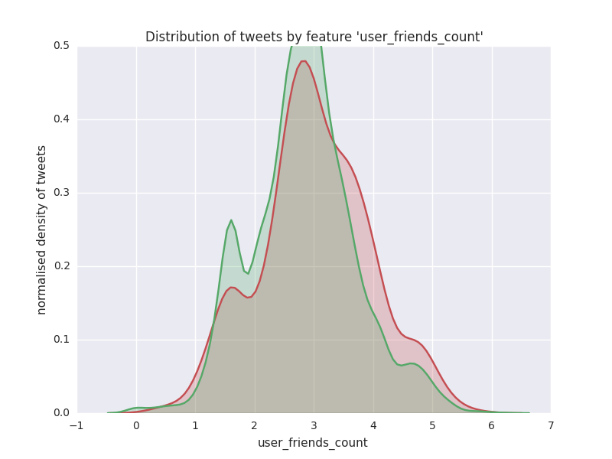
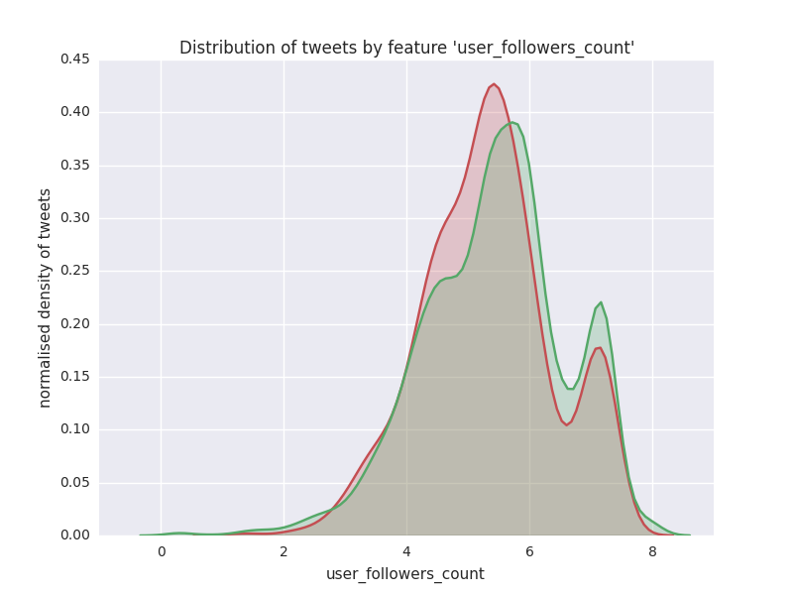
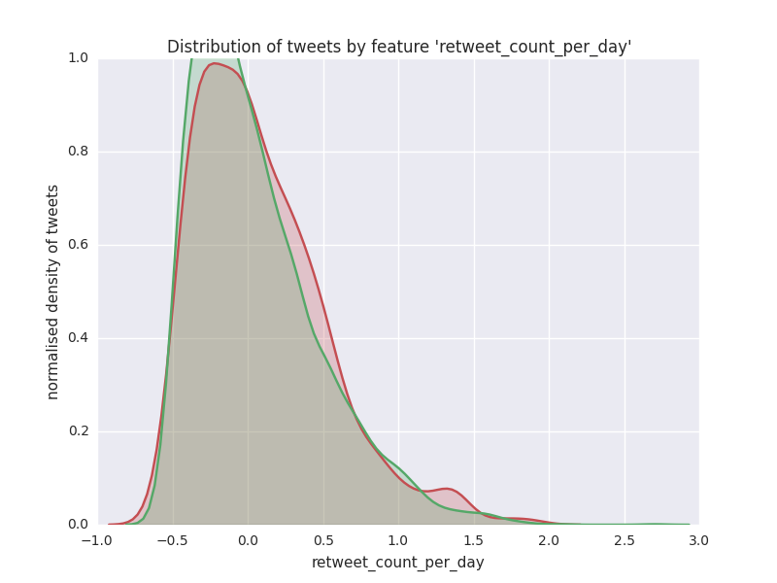
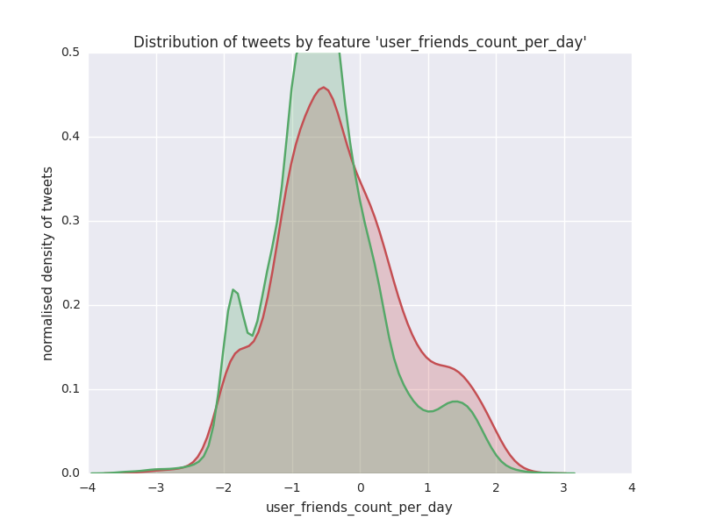
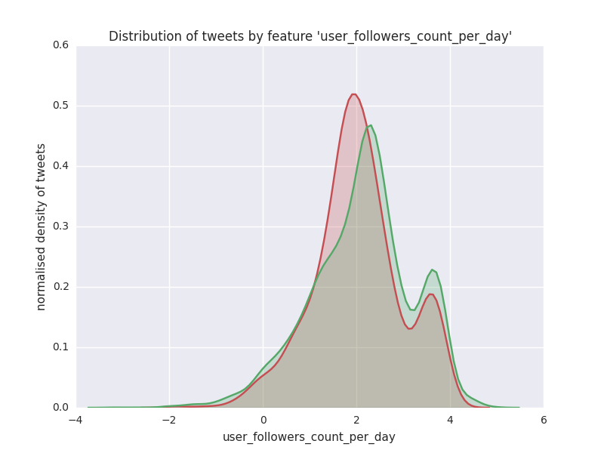
per-unit-time related features (log10)
∆µ = -0.0247, p = 0.523
∆µ = 0.0830, p = 0.0320
∆µ = -0.126, p = 0.00111
∆µ = 0.0268, p = 0.489
∆µ = 0.129, p = 0.000829
∆µ = -0.143, p = 0.000233

Slide 8
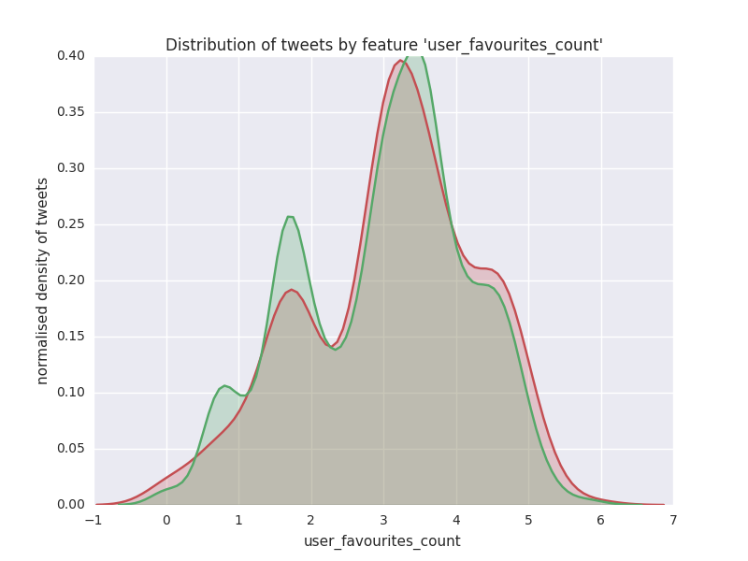
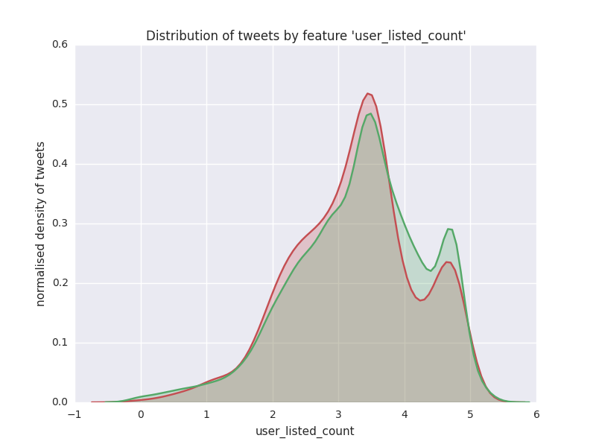
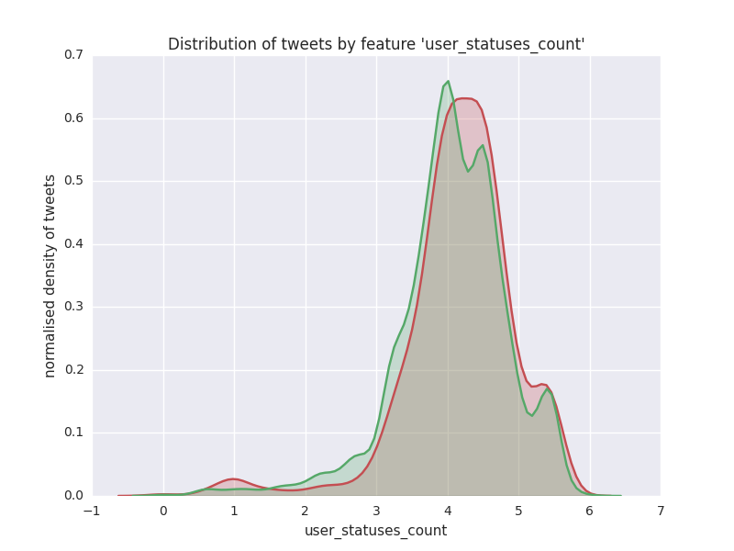
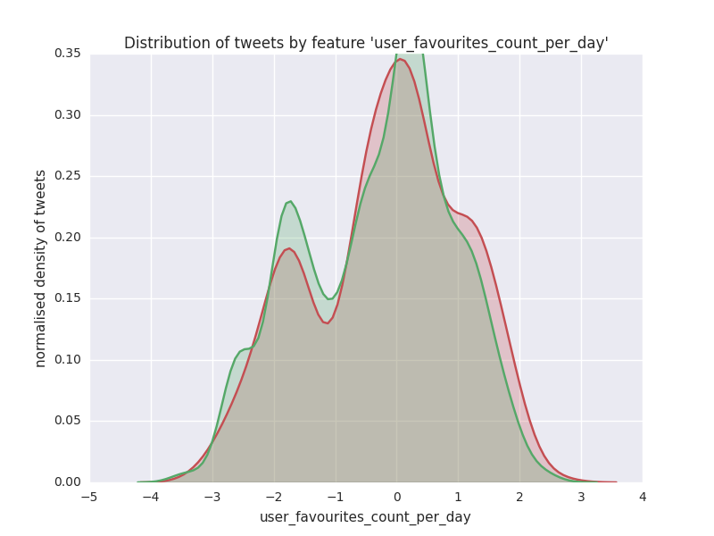
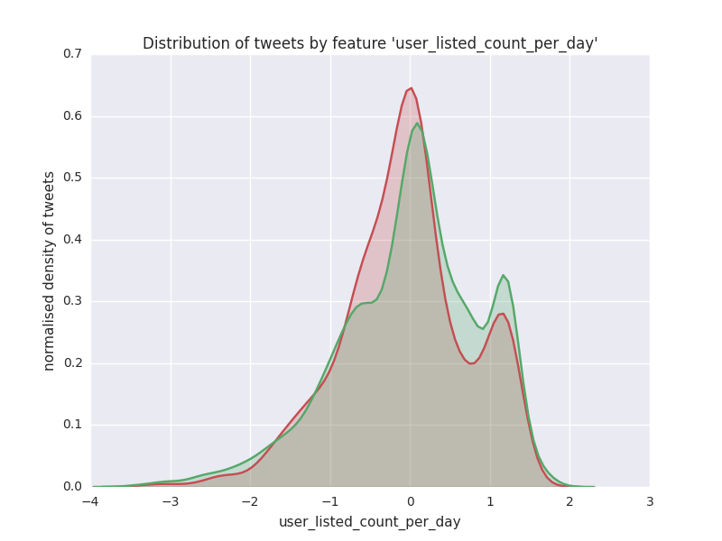
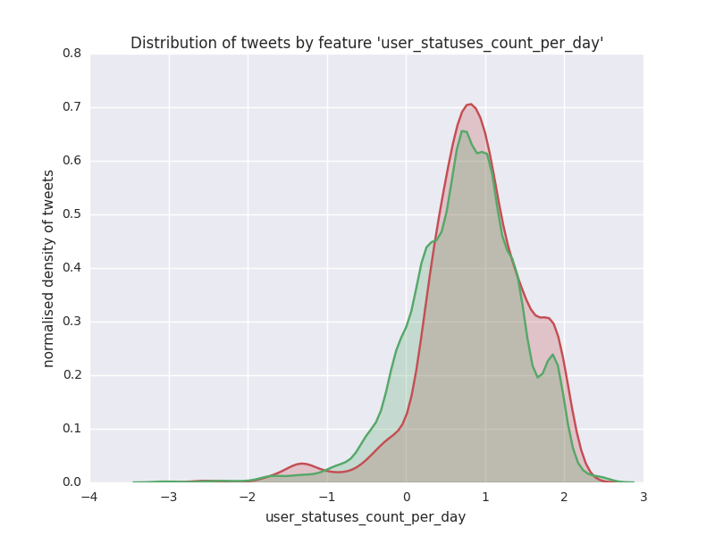
per-unit-time related features (log10)
∆µ = 0.0680, p = 0.0790
∆µ = -0.0991, p = 0.0105
∆µ = 0.0767, p = 0.0476
∆µ = 0.0990, p = 0.0106
∆µ = -0.132, p = 0.000680
∆µ = 0.115, p = 0.00291

Slide 9
text-related features
FEATURE | DIFF MEAN | P VALUE
text_num_caps_digits | 0.328508469805197 | 0.00000000000000001817
text_num_caps_digits_exclam | 0.320376289091854 | 0.00000000000000011032
text_num_caps | 0.284341784083254 | 0.00000000000018982640
text_num_caps_exclam | 0.276391941495619 | 0.00000000000087281045
text_num_digits | 0.272337246767137 | 0.00000000000186958317
text_num_swears | -0.115639271995914 | 0.00282836836204724000
text_num_nonstandard | 0.063133372168354 | 0.10317168793059400000
text_num_nonstandard_extended | 0.048553312639814 | 0.21011337294653800000
text_num_exclam | -0.009094815310897 | 0.81441095787411000000
FEATURE | DIFF MEAN | P VALUE
user_screen_name_has_caps_digits | 0.262285988688136 | 0.00000000001178100595
user_screen_name_num_caps_digits | 0.225172500229789 | 0.00000000588121100628
user_screen_name_has_caps_digits_underscores | 0.220518463593140 | 0.00000001201798678693
user_screen_name_num_caps_digits_underscores | 0.216318353886877 | 0.00000002262544180715
user_screen_name_has_caps | 0.206996667603478 | 0.00000008838704498429
user_screen_name_num_caps | 0.177737513482832 | 0.00000439979639098320
user_screen_name_num_caps_underscores | 0.168496131447383 | 0.00001346469570402120
user_screen_name_has_caps_underscores | 0.161481492528789 | 0.00003033387736915430
user_screen_name_has_digits | 0.155118614476325 | 0.00006165950921821620
user_screen_name_num_digits | 0.133110918511019 | 0.00058745594493451000
user_screen_name_num_digits_underscores | 0.110560873515159 | 0.00430932407291492000
user_screen_name_num_weird_chars | 0.110560873515159 | 0.00430932407291492000
user_screen_name_has_digits_underscores | 0.060639335522454 | 0.11751832452650200000
user_screen_name_has_weird_chars | 0.060639335522454 | 0.11751832452650200000
user_screen_name_has_underscores | -0.028897507148646 | 0.45574730213312300000
user_screen_name_num_underscores | -0.027552309134123 | 0.47699401643818400000
FEATURE | DIFF MEAN | P VALUE
user_description_num_exclam | 0.150950653420117 | 0.00009675917875963300
user_description_num_caps_exclam | 0.121901143581656 | 0.00164608597263901000
user_description_num_non_a_to_z | 0.114943253249033 | 0.00299923689022872000
user_description_num_caps | 0.114512461659785 | 0.00310965737703582000
user_description_num_non_a_to_z_non_digits | 0.114507752043833 | 0.00311088476024148000
user_description_num_caps_with_num_nonstandard | 0.114368994414807 | 0.00314724544039675000
user_description_num_nonstandard | 0.084096404735919 | 0.02993281139725200000
user_description_num_nonstandard_extended | 0.054021652644027 | 0.16318955311498100000
user_description_num_digits | 0.039756151198316 | 0.30481632729323100000
FEATURE | DIFF MEAN | P VALUE
user_name_has_weird_chars | 0.094534681286187 | 0.01466390719685070000
user_name_has_underscores | 0.089929887442158 | 0.02025241432449590000
user_name_has_digits_underscores | 0.085898104988500 | 0.02658832483519980000
user_name_has_nonprintable_chars | 0.068094032521295 | 0.07878999542386130000
user_name_has_caps_digits | 0.053377805119681 | 0.16826434210917700000
user_name_has_caps | 0.045822150476645 | 0.23690878845441800000
user_name_num_digits_underscores | 0.043565275499711 | 0.26080589854854900000
user_name_num_weird_chars | 0.042632887635448 | 0.27114939598233300000
user_name_num_nonprintable_chars | 0.041769560980110 | 0.28097418974511000000
user_name_has_caps_underscores | 0.040632640844963 | 0.29427702016733700000
user_name_has_caps_digits_underscores | 0.039421456149658 | 0.30890613237491100000
user_name_num_digits | 0.036001457629479 | 0.35276549231467300000
user_name_num_underscores | 0.033341590172670 | 0.38946950124127400000
user_name_has_digits | 0.022438616439895 | 0.56248580648111200000
user_name_num_caps_digits_underscores | 0.021013635357653 | 0.58756178677826800000
user_name_num_caps_underscores | 0.015661773926583 | 0.68603906159413600000
user_name_num_caps_digits | 0.009008668192290 | 0.81613728320399300000
user_name_num_caps | 0.002906504401600 | 0.94020082866916800000

Slide 10
All features
user_listed_count | -0.099054697681362 | 0.01054790630598750000
user_favourites_count_per_day | 0.098958024473082 | 0.01062387878845050000
user_name_has_weird_chars | 0.094534681286187 | 0.01466390719685070000
user_name_has_underscores | 0.089929887442158 | 0.02025241432449590000
user_name_has_digits_underscores | 0.085898104988500 | 0.02658832483519980000
user_description_num_nonstandard | 0.084096404735919 | 0.02993281139725200000
user_friends_count | 0.083044103896057 | 0.03204874419941480000
user_default_profile | 0.080376062248807 | 0.03799576178479910000
created_at_hour_of_week | -0.079448339664958 | 0.04027251939954340000
user_created_at_delta | -0.078195521824918 | 0.04352982368808180000
user_statuses_count | 0.076734653944410 | 0.04760632681384590000
created_at_weekday | -0.074366010607228 | 0.05489567292437250000
user_name_has_nonprintable_chars | 0.068094032521295 | 0.07878999542386130000
user_favourites_count | 0.068046610466555 | 0.07899865235454690000
num_mentions | 0.064822633303216 | 0.09427154344597160000
text_num_nonstandard | 0.063133372168354 | 0.10317168793059400000
tweet_id | 0.063049950829170 | 0.10362794925576800000
user_screen_name_has_digits_underscores | 0.060639335522454 | 0.11751832452650200000
user_screen_name_has_weird_chars | 0.060639335522454 | 0.11751832452650200000
user_description_num_nonstandard_extended | 0.054021652644027 | 0.16318955311498100000
user_name_has_caps_digits | 0.053377805119681 | 0.16826434210917700000
num_mentions_is_more_than_2 | 0.052343384253203 | 0.17666424979961500000
text_num_nonstandard_extended | 0.048553312639814 | 0.21011337294653800000
user_name_has_caps | 0.045822150476645 | 0.23690878845441800000
created_at_hour | -0.045140846024975 | 0.24395385387751200000
user_name_num_digits_underscores | 0.043565275499711 | 0.26080589854854900000
user_name_num_weird_chars | 0.042632887635448 | 0.27114939598233300000
user_name_num_nonprintable_chars | 0.041769560980110 | 0.28097418974511000000
user_name_has_caps_underscores | 0.040632640844963 | 0.29427702016733700000
user_description_num_digits | 0.039756151198316 | 0.30481632729323100000
user_name_has_caps_digits_underscores | 0.039421456149658 | 0.30890613237491100000
num_hashtags_is_nonzero | 0.037645605063081 | 0.33121019136142000000
user_name_num_digits | 0.036001457629479 | 0.35276549231467300000
user_name_num_underscores | 0.033341590172670 | 0.38946950124127400000
geo_coordinates | 0.029147327335745 | 0.45186097138484200000
num_hashtags | 0.029147327335745 | 0.45186097138484200000
user_screen_name_has_underscores | -0.028897507148646 | 0.45574730213312300000
user_screen_name_num_underscores | -0.027552309134123 | 0.47699401643818400000
retweet_count_per_day | 0.026792257249070 | 0.48923423972190300000
retweet_count | -0.024747089874719 | 0.52299328861291900000
user_name_has_digits | 0.022438616439895 | 0.56248580648111200000
user_name_num_caps_digits_underscores | 0.021013635357653 | 0.58756178677826800000
user_name_num_caps_underscores | 0.015661773926583 | 0.68603906159413600000
user_default_profile_image | 0.014059915293107 | 0.71668622458125300000
text_num_exclam | -0.009094815310897 | 0.81441095787411000000
user_name_num_caps_digits | 0.009008668192290 | 0.81613728320399300000
user_name_num_caps | 0.002906504401600 | 0.94020082866916800000
0.01 ≤ p < 0.05
FEATURE | DIFF MEAN | P VALUE
user_verified | -0.334862652593959 | 0.00000000000000000430
text_num_caps_digits | 0.328508469805197 | 0.00000000000000001817
text_num_caps_digits_exclam | 0.320376289091854 | 0.00000000000000011032
text_num_caps | 0.284341784083254 | 0.00000000000018982640
text_num_caps_exclam | 0.276391941495619 | 0.00000000000087281045
text_num_digits | 0.272337246767137 | 0.00000000000186958317
user_screen_name_has_caps_digits | 0.262285988688136 | 0.00000000001178100595
user_screen_name_num_caps_digits | 0.225172500229789 | 0.00000000588121100628
user_screen_name_has_caps_digits_underscores | 0.220518463593140 | 0.00000001201798678693
user_screen_name_num_caps_digits_underscores | 0.216318353886877 | 0.00000002262544180715
user_screen_name_has_caps | 0.206996667603478 | 0.00000008838704498429
num_urls_is_nonzero | 0.193751829686201 | 0.00000055546626709527
num_urls | 0.192759060318776 | 0.00000063457724714638
user_screen_name_num_caps | 0.177737513482832 | 0.00000439979639098320
created_at_weekday_sun_mon_tue | 0.176202799872474 | 0.00000531821008238821
user_screen_name_num_caps_underscores | 0.168496131447383 | 0.00001346469570402120
user_screen_name_has_caps_underscores | 0.161481492528789 | 0.00003033387736915430
user_screen_name_has_digits | 0.155118614476325 | 0.00006165950921821620
user_description_num_exclam | 0.150950653420117 | 0.00009675917875963300
user_followers_count_per_day | -0.142513168885046 | 0.00023286248761311800
user_screen_name_num_digits | 0.133110918511019 | 0.00058745594493451000
user_listed_count_per_day | -0.131571815531587 | 0.00067990384942370200
user_friends_count_per_day | 0.129452328814406 | 0.00082945532326780700
user_followers_count | -0.126288845970021 | 0.00111016076037015000
num_media | -0.126018499508719 | 0.00113783067671653000
created_at_hour_18_to_00 | -0.125111745368415 | 0.00123535800778445000
num_media_is_nonzero | -0.125054182010775 | 0.00124180263026520000
user_description_num_caps_exclam | 0.121901143581656 | 0.00164608597263901000
created_at_hour_08_to_17 | 0.121817302581855 | 0.00165832748771026000
text_num_swears | -0.115639271995914 | 0.00282836836204724000
user_statuses_count_per_day | 0.115292888911431 | 0.00291226034527856000
user_description_num_non_a_to_z | 0.114943253249033 | 0.00299923689022872000
user_description_num_caps | 0.114512461659785 | 0.00310965737703582000
user_description_num_non_a_to_z_non_digits | 0.114507752043833 | 0.00311088476024148000
user_description_num_caps_with_num_nonstandard | 0.114368994414807 | 0.00314724544039675000
user_profile_use_background_image | 0.110840963665571 | 0.00421215183874502000
user_screen_name_num_digits_underscores | 0.110560873515159 | 0.00430932407291492000
user_screen_name_num_weird_chars | 0.110560873515159 | 0.00430932407291492000
p < 0.01
p ≥ 0.05

Slide 12
Model performance evaluation

Slide 13
Evaluation method
Use the same feature set for evaluation of all models → consistency in results
Use K-fold cross-validation (k=5) → decrease variance of model scores
Upsample minority class (‘fake news’) to 1:1 during training, while keeping original class proportions (~1:8) for testing → if there was no upsampling, the classifier would learn to classify all data as ‘other news’ to maximize accuracy
Test logistic regression, SVM, KNN, random forest models with different hyperparameters and note the results → use grid search to loop through relevant ranges for hyperparameters
For each model note the model parameters which maximize the ROC AUC score (maximizing accuracy causes all data to be classified as ‘other news’ due to imbalanced data set, therefore accuracy is not a good metric here)

Slide 14
Logistic Regression – testing method
Use logistic regression model with liblinear solver and l1 penalty
Run logistic regression with different feature sets, note resulting performances
Choose the feature set with high ROC AUC value and reasonable features included (don’t include all features since this may cause overfitting)

Slide 15
Logistic Regression – results
results are sorted by mean ROC AUC score
feature_set | mean_accuracy_score | mean_roc_auc_score | mean_precision_score | mean_recall_score | mean_f1_score | mean_cm_TN | mean_cm_FP | mean_cm_FN | mean_cm_TP
features_extended_some_multiple | 0.622322627 | 0.656842461 | 0.195162758 | 0.608326967 | 0.295385728 | 640.4 | 385.2 | 60 | 93.2
features_extended_some_single | 0.615196504 | 0.653507112 | 0.193286013 | 0.614854427 | 0.293944347 | 631 | 394.6 | 59 | 94.2
features_extended_some_multiple_without_text_num_swears | 0.622322196 | 0.651971269 | 0.192110256 | 0.592640693 | 0.290029959 | 642.8 | 382.8 | 62.4 | 90.8
features_extended_some_multiple_without_biasing_features | 0.624354655 | 0.651012711 | 0.192117706 | 0.587394958 | 0.289382631 | 646 | 379.6 | 63.2 | 90
features_extended_all_reduced | 0.631823648 | 0.650918979 | 0.196633277 | 0.592717087 | 0.295247988 | 654 | 371.6 | 62.4 | 90.8
features_extended_all | 0.633348927 | 0.648506836 | 0.197754208 | 0.594015788 | 0.296644288 | 655.6 | 370 | 62.2 | 91
features_extended_some_single_without_biasing_features | 0.614515947 | 0.648401415 | 0.191212703 | 0.604371446 | 0.290262392 | 631.8 | 393.8 | 60.6 | 92.6
features_extended_few_multiple | 0.614175526 | 0.639212461 | 0.184805381 | 0.576911977 | 0.279832426 | 635.6 | 390 | 64.8 | 88.4
features_extended_few_single | 0.603828348 | 0.638716343 | 0.177606619 | 0.565164248 | 0.270145401 | 625.2 | 400.4 | 66.6 | 86.6
features_basic_some | 0.624547881 | 0.596672056 | 0.171323113 | 0.480256345 | 0.249697647 | 662.6 | 363 | 79.6 | 73.6
features_basic_all | 0.622330391 | 0.592582537 | 0.169846611 | 0.48424582 | 0.250343994 | 659.4 | 366.2 | 79 | 74.2
features_basic_few | 0.615383831 | 0.58801292 | 0.170008974 | 0.486800781 | 0.247907816 | 650.8 | 374.8 | 78.6 | 74.6
features_extended_some_multiple has the highest ROC AUC score but text_num_swears wasn’t a good feature → choose features_extended_some_multiple_without_text_num_swears instead
for details on which features are included in which feature set, please see the source of models.py file

Slide 16
Logistic regression – chosen feature set
features_extended_some_multiple_without_text_num_swears feature set contains the following features:
The same feature set is used for training SVM, KNN, Random Forests
user_verified
text_num_caps
text_num_digits
user_screen_name_has_caps
user_screen_name_has_digits
num_urls_is_nonzero
user_description_num_exclam
user_followers_count_per_day
user_listed_count_per_day
user_followers_count
user_statuses_count_per_day
user_description_num_caps
user_favourites_count_per_day
user_name_has_weird_chars
user_default_profile
created_at_weekday_sun_mon_tue
created_at_hour_08_to_17
user_friends_count_per_day
num_media
created_at_hour_18_to_00
user_profile_use_background_image
created_at_weekday
user_listed_count
created_at_hour
user_friends_count
user_created_at_delta
user_statuses_count

Slide 17
SVM – testing method
Determine performances of SVM model with different hyperparameters using grid search:
Kernel ∈ {linear, polynomial, RBF, sigmoid}
Polynomial: degree ∈ {2, 3, 4, 5}
RBF: gamma ∈ {?}
Maximum number of iterations ∈ {1, 5} * 10^{1 ,2, 3, 4, 5, 6}
C ∈ {1, 5} * 10^{-15, -14, …, 14, 15}

Slide 18
SVM – results
results are sorted by mean ROC AUC score
kernel | max_iter | poly_degree | C | mean_accuracy_score | mean_roc_auc_score | mean_precision_score | mean_recall_score | mean_f1_score | mean_cm_TN | mean_cm_FP | mean_cm_FN | mean_cm_TP
linear | 100000 | 0 | 1.00E-12 | 0.467594389 | 0.568646156 | 0.110392233 | 0.566114931 | 0.166113391 | 464.2 | 561.4 | 66.4 | 86.8
linear | 5000000 | 0 | 5.00E-11 | 0.538071355 | 0.565076114 | 0.139573531 | 0.484475002 | 0.189029666 | 560 | 465.6 | 79 | 74.2
linear | 500000 | 0 | 1.00E-12 | 0.393067042 | 0.563481675 | 0.137912132 | 0.678533232 | 0.213361743 | 359.2 | 666.4 | 49.2 | 104
linear | 1000000 | 0 | 1.00E-12 | 0.393067042 | 0.562555564 | 0.137912132 | 0.678533232 | 0.213361743 | 359.2 | 666.4 | 49.2 | 104
linear | 5000000 | 0 | 1.00E-12 | 0.393067042 | 0.562555564 | 0.137912132 | 0.678533232 | 0.213361743 | 359.2 | 666.4 | 49.2 | 104
linear | 5000000 | 0 | 5.00E-12 | 0.48993346 | 0.561898114 | 0.142832409 | 0.567625838 | 0.20084771 | 490.4 | 535.2 | 66.2 | 87
linear | 500000 | 0 | 5.00E-13 | 0.225155471 | 0.561176437 | 0.134262577 | 0.909905781 | 0.233963356 | 126 | 899.6 | 13.8 | 139.4
linear | 5000 | 0 | 1.00E-14 | 0.1409936 | 0.560792897 | 0.131291594 | 0.998692811 | 0.232072698 | 13.2 | 1012.4 | 0.2 | 153
linear | 10000 | 0 | 1.00E-13 | 0.294977365 | 0.560208623 | 0.105879402 | 0.796078431 | 0.186894117 | 225.6 | 800 | 31.2 | 122
linear | 5000000 | 0 | 5.00E-13 | 0.225155471 | 0.558144738 | 0.134262577 | 0.909905781 | 0.233963356 | 126 | 899.6 | 13.8 | 139.4
linear | 10000 | 0 | 5.00E-14 | 0.352140305 | 0.558007325 | 0.105653283 | 0.71517698 | 0.184102455 | 305.4 | 720.2 | 43.6 | 109.6
showing first 11 out of 5208 results

Slide 19
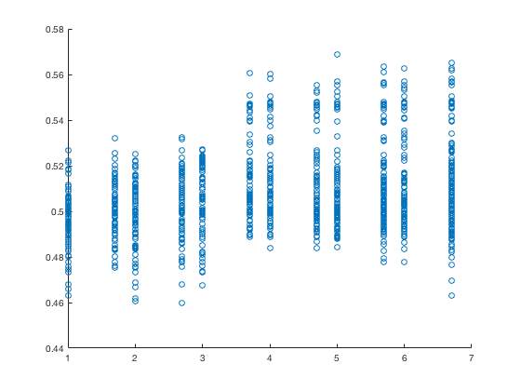
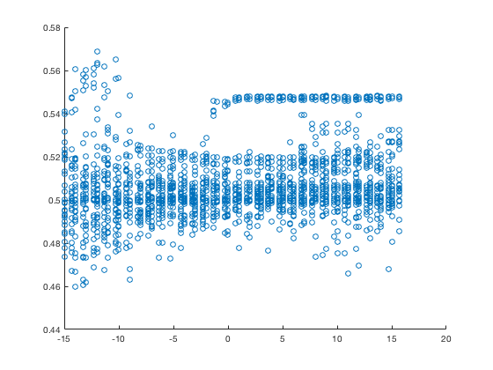
SVM – graphs
ROC AUC score vs log10(maximum number of iterations)
ROC AUC score vs log10(C)

Slide 20
KNN – testing method
Use K nearest neighbours model with k ∈ {1, 2, …, 199, 200}
Determine for which k the ROC AUC score is maximised

Slide 21
KNN – results
results are sorted by mean ROC AUC score
n_neighbors | mean_accuracy_score | mean_roc_auc_score | mean_precision_score | mean_recall_score | mean_f1_score | mean_cm_TN | mean_cm_FP | mean_cm_FN | mean_cm_TP
147 | 0.626736892 | 0.651695297 | 0.193487404 | 0.591460827 | 0.291542832 | 648.2 | 377.4 | 62.6 | 90.6
148 | 0.634371634 | 0.651618482 | 0.196732336 | 0.588846448 | 0.294884886 | 657.6 | 368 | 63 | 90.2
146 | 0.635220243 | 0.651606691 | 0.195335752 | 0.579704609 | 0.292156503 | 660 | 365.6 | 64.4 | 88.8
149 | 0.627415001 | 0.651155166 | 0.194895783 | 0.596672608 | 0.293778749 | 648.2 | 377.4 | 61.8 | 91.4
145 | 0.629111355 | 0.651019064 | 0.194449911 | 0.590136661 | 0.292473619 | 651.2 | 374.4 | 62.8 | 90.4
150 | 0.636408841 | 0.65096015 | 0.197294279 | 0.58622358 | 0.29519591 | 660.4 | 365.2 | 63.4 | 89.8
130 | 0.631992421 | 0.650926866 | 0.190302579 | 0.562728122 | 0.284347345 | 658.8 | 366.8 | 67 | 86.2
126 | 0.631484667 | 0.650878184 | 0.190220352 | 0.564043799 | 0.284417103 | 658 | 367.6 | 66.8 | 86.4
155 | 0.629619973 | 0.650802431 | 0.194451533 | 0.588837959 | 0.292308793 | 652 | 373.6 | 63 | 90.2
…
10 | 0.641667536 | 0.613180275 | 0.187246933 | 0.526135303 | 0.276128915 | 675.8 | 349.8 | 72.6 | 80.6
9 | 0.604852777 | 0.610886 | 0.17684494 | 0.558764112 | 0.26855781 | 627.4 | 398.2 | 67.6 | 85.6
6 | 0.68459449 | 0.605680388 | 0.186846178 | 0.426924709 | 0.259864136 | 741.6 | 284 | 87.8 | 65.4
8 | 0.649475941 | 0.604930561 | 0.185388081 | 0.501358119 | 0.270540613 | 688.8 | 336.8 | 76.4 | 76.8
7 | 0.632847793 | 0.604576374 | 0.18197415 | 0.523546388 | 0.269947098 | 665.8 | 359.8 | 73 | 80.2
5 | 0.674753049 | 0.604214471 | 0.185392004 | 0.443909685 | 0.261487639 | 727.4 | 298.2 | 85.2 | 68
4 | 0.737359718 | 0.600826355 | 0.205092487 | 0.355122655 | 0.259885785 | 814.8 | 210.8 | 98.8 | 54.4
3 | 0.733117539 | 0.585738487 | 0.202611979 | 0.359018759 | 0.258905428 | 809.2 | 216.4 | 98.2 | 55
2 | 0.804720639 | 0.578425738 | 0.235930246 | 0.225914608 | 0.230637165 | 914 | 111.6 | 118.6 | 34.6
1 | 0.804381368 | 0.558911046 | 0.236117732 | 0.227221798 | 0.231429117 | 913.4 | 112.2 | 118.4 | 34.8
showing first 9 and last 10 results out of 200

Slide 23
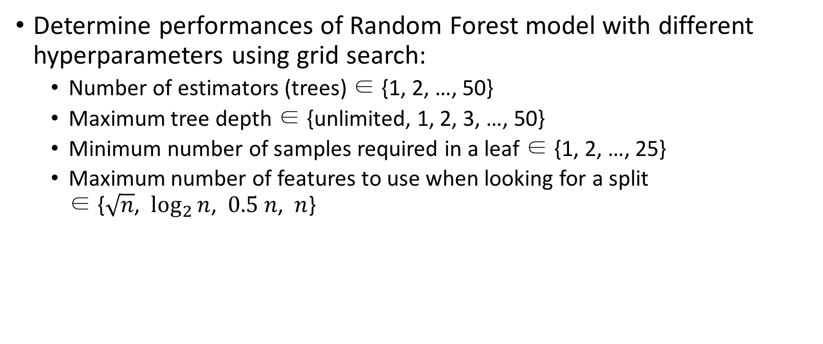
Random Forest – testing method
Determine performances of Random Forest model with different hyperparameters using grid search:
Number of estimators (trees) ∈ {1, 2, …, 50}
Maximum tree depth ∈ {unlimited, 1, 2, 3, …, 50}
Minimum number of samples required in a leaf ∈ {1, 2, …, 25}
Maximum number of features to use when looking for a split ∈ {$\sqrt{n}$, $\log_{2}{n}$, $0.5 n$, $n$}

Slide 24
Random Forest – results
results are sorted by mean ROC AUC score
n_estimators | max_depth | min_samples_leaf | max_features | mean_accuracy_score | mean_roc_auc_score | mean_precision_score | mean_recall_score | mean_f1_score | mean_cm_TN | mean_cm_FP | mean_cm_FN | mean_cm_TP
49 | 8 | 12 | sqrt | 0.738544288 | 0.7119453 | 0.257725739 | 0.539156269 | 0.348556925 | 788 | 237.6 | 70.6 | 82.6
48 | 8 | 12 | sqrt | 0.739223548 | 0.711868295 | 0.259080159 | 0.541770648 | 0.350353495 | 788.4 | 237.2 | 70.2 | 83
50 | 8 | 12 | sqrt | 0.738885141 | 0.711830041 | 0.258341597 | 0.540471946 | 0.349410962 | 788.2 | 237.4 | 70.4 | 82.8
42 | 8 | 12 | sqrt | 0.738374796 | 0.71165972 | 0.25703447 | 0.5352347 | 0.34703612 | 788.4 | 237.2 | 71.2 | 82
41 | 8 | 12 | sqrt | 0.735999613 | 0.71155856 | 0.25447047 | 0.533935999 | 0.344456996 | 785.8 | 239.8 | 71.4 | 81.8
44 | 8 | 12 | sqrt | 0.738544144 | 0.711412076 | 0.257473007 | 0.53654189 | 0.347796489 | 788.4 | 237.2 | 71 | 82.2
47 | 8 | 12 | sqrt | 0.739222397 | 0.711326597 | 0.258337936 | 0.539156269 | 0.349101734 | 788.8 | 236.8 | 70.6 | 82.6
43 | 8 | 12 | sqrt | 0.740919182 | 0.711210194 | 0.260333402 | 0.539156269 | 0.350885531 | 790.8 | 234.8 | 70.6 | 82.6
46 | 8 | 12 | sqrt | 0.739223836 | 0.711100421 | 0.257837675 | 0.53654189 | 0.348090207 | 789.2 | 236.4 | 71 | 82.2
39 | 8 | 12 | sqrt | 0.736339316 | 0.711016406 | 0.255730053 | 0.539164757 | 0.346745453 | 785.4 | 240.2 | 70.6 | 82.6
50 | 10 | 15 | log2 | 0.762299857 | 0.710971439 | 0.266111063 | 0.471267295 | 0.340122542 | 826.4 | 199.2 | 81 | 72.2
50 | 9 | 17 | log2 | 0.751612397 | 0.710956638 | 0.269200335 | 0.531313131 | 0.35729071 | 804.6 | 221 | 71.8 | 81.4
49 | 9 | 17 | log2 | 0.75110306 | 0.710885468 | 0.267104693 | 0.52479416 | 0.353986003 | 805 | 220.6 | 72.8 | 80.4
40 | 8 | 12 | sqrt | 0.737526619 | 0.710829466 | 0.257542747 | 0.541779136 | 0.348939529 | 786.4 | 239.2 | 70.2 | 83

Slide 25
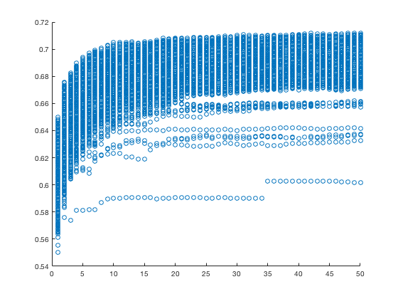
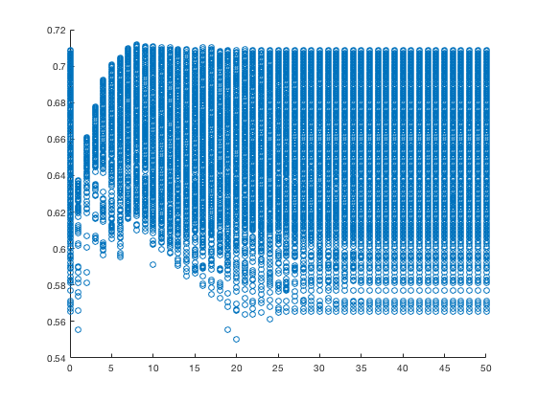
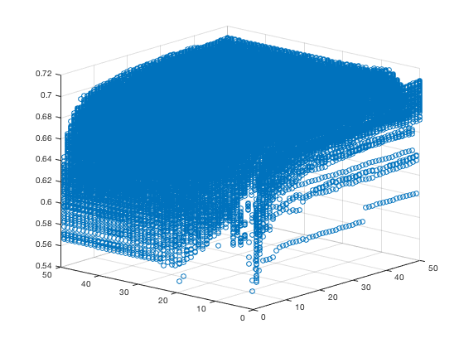
Random Forest – graphs
ROC AUC score vs number of estimators
ROC AUC score vs maximum tree depth (zero depth = unlimited depth)
ROC AUC score vs number of estimators and maximum tree depth

Slide 26
Best model
best results for each model are sorted by mean ROC AUC score
model | model-specific hyperparameters |  |  |  | mean_accuracy_score | mean_roc_auc_score | mean_precision_score | mean_recall_score | mean_f1_score | mean_cm_TN | mean_cm_FP | mean_cm_FN | mean_cm_TP
random forest | n_estimators | max_depth | min_samples_leaf | max_features | 0.738544288 | 0.711945300 | 0.257725739 | 0.539156269 | 0.348556925 | 788.0 | 237.6 | 70.6 | 82.6
 | 49 | 8 | 12 | sqrt
logistic regression | feature_set |  |  |  | 0.622322196 | 0.651971269 | 0.192110256 | 0.592640693 | 0.290029959 | 642.8 | 382.8 | 62.4 | 90.8
 | features_extended_some_multiple_without_text_num_swears
KNN | n_neighbors |  |  |  | 0.626736892 | 0.651695297 | 0.193487404 | 0.591460827 | 0.291542832 | 648.2 | 377.4 | 62.6 | 90.6
 | 147
SVM | kernel | max_iter | poly_degree | C | 0.467594389 | 0.568646156 | 0.110392233 | 0.566114931 | 0.166113391 | 464.2 | 561.4 | 66.4 | 86.8
 | linear | 100000 | N/A | 1.00E-12
best model: Random Forest (n=49, depth=8, min_samples_leaf=12, max_features=sqrt)
with ROC AUC = 71.2%, accuracy = 73.9%, precision = 25.8%, recall 53.9%

Slide 27
Future work
Manually label more tweets and rerun the pipelines with more data
Perform analysis using also the 5 subcategories of fake news
Try new classification models
neural networks, naive Bayes?

